Slide 1


Pandas
Digital Career Program
Data Analytics II
Part 3.1
Data Aggregation

Slide 2
Outlines
Introduction
Data Selection
Data Manipulation
Data Aggregation
Data Merging
Data Cleaning
Data Reshaping

Slide 3
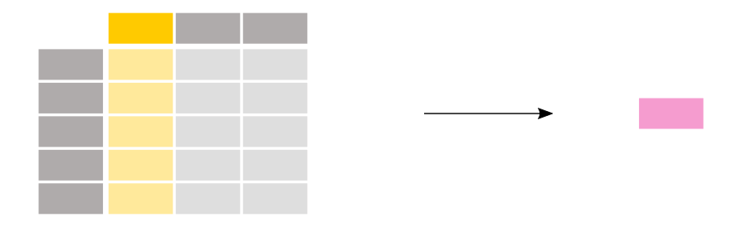
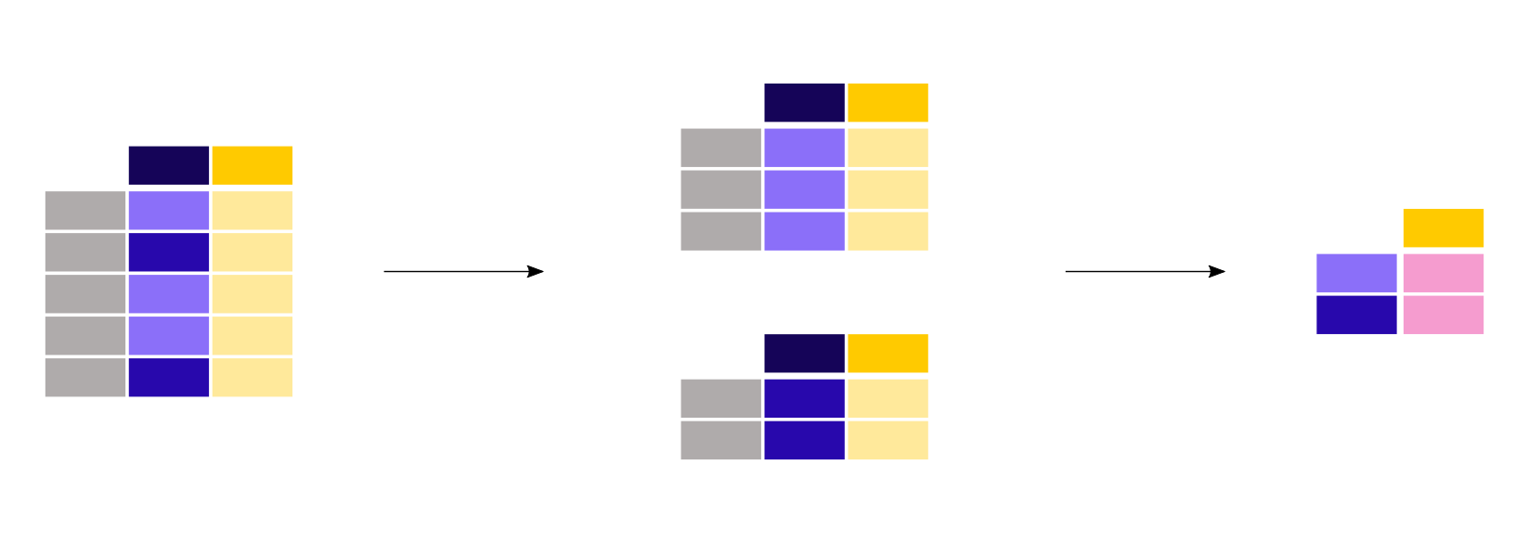
Aggregation
Summary statistics
GroupBy
Notes:
mathematical or logical operation on data with a summarisation as a result
Summary of a single column
Grouping of column values into a new table

Slide 4
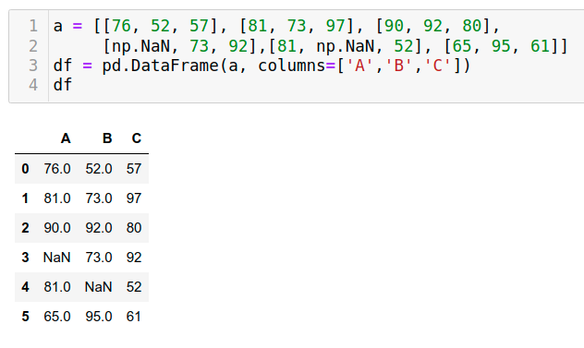
Aggregating Statistics
Count
Sum
Mean (average)
Min, Max
Variance, Standard deviation (std)
Median
Mode

Slide 5
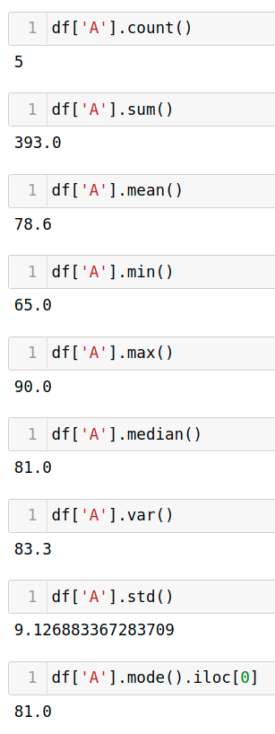
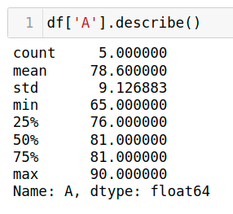
Aggregating Statistics
Column-wise
Single column

Slide 6
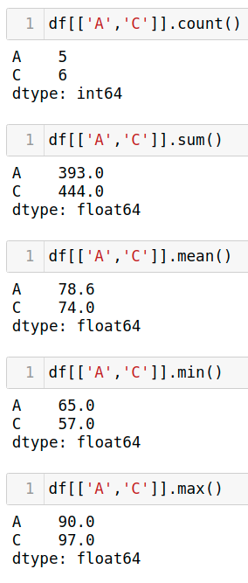
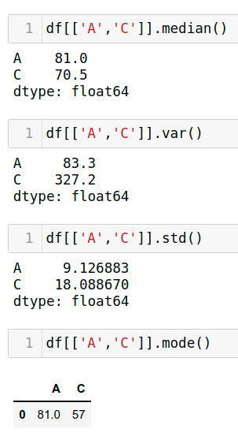
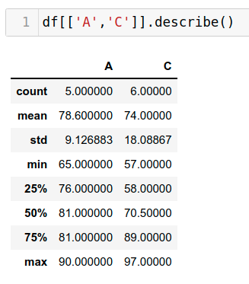
Aggregating Statistics
Column-wise
Multiple columns

Slide 7
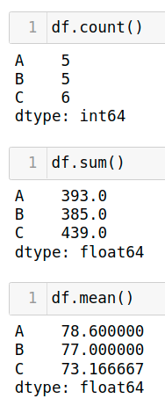
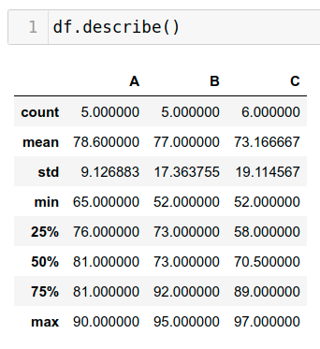
Aggregating Statistics
Column-wise
All columns

Slide 8
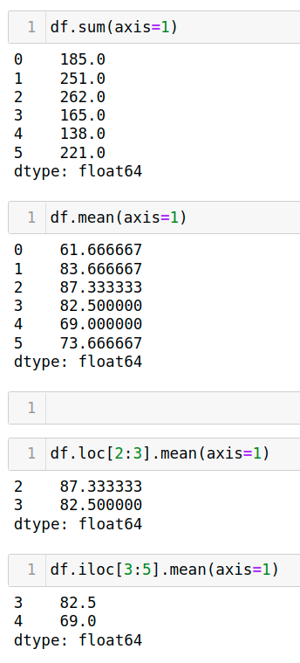
Aggregating Statistics
Row-wise

Slide 9
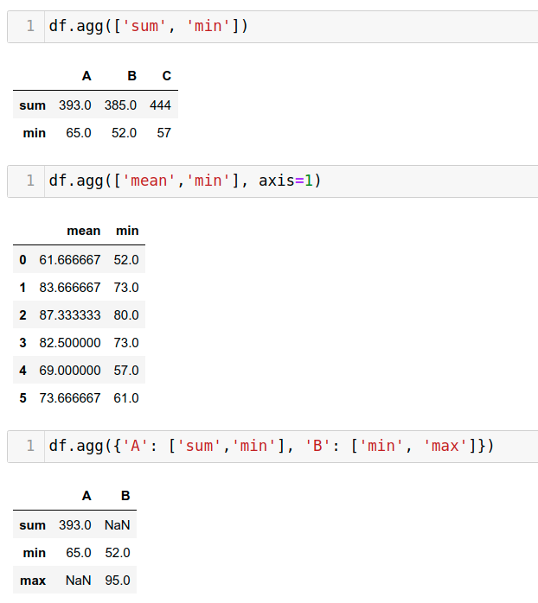
Aggregating Statistics
agg() function
Aggregate using one or more operations over a specified axis
Notes:
In pandas axis = 0 refers to horizontal axis or rows and axis = 1 refers to vertical axis or columns

Slide 10
GroupBy
Aggregating statistics grouped by category
The groupby() method is applied on one or more columns to make a group per category.

Slide 11
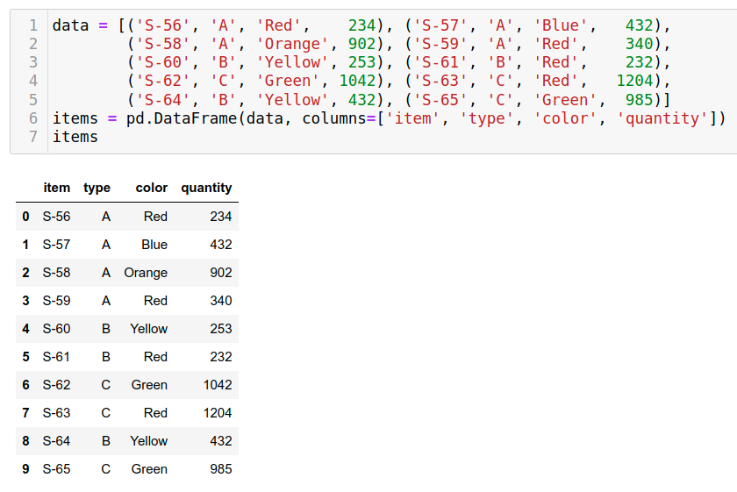
GroupBy
In a store, there are many items..
An item has a Type and a Color ..
We have a dataset of items, with the quantity of each item..

Slide 12
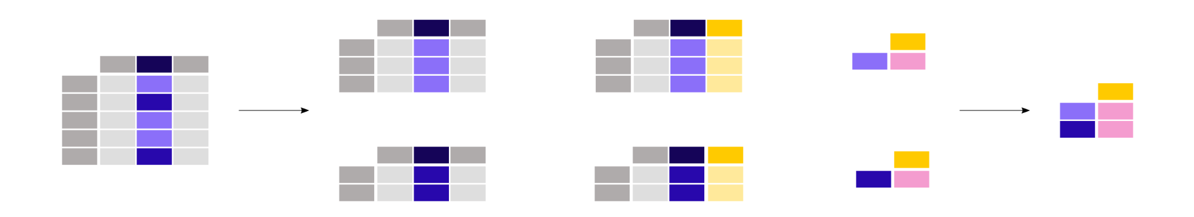
GroupBy
Find the sum of quantities for each Type
Approach:
Split the dataset into groups (per Type)
Apply sum() function to each group independently
Combine the results into a data structure
Notes:
How could you split the dataset into groups per type in python?
df.loc[df[‘type'] == ‘A’]

Slide 13
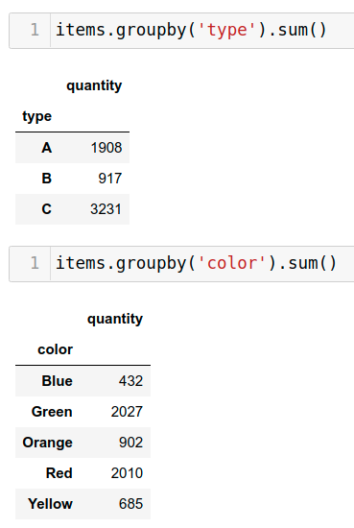
GroupBy
Find the sum of quantities for each Type
Find the sum of quantities for each Color

Slide 14
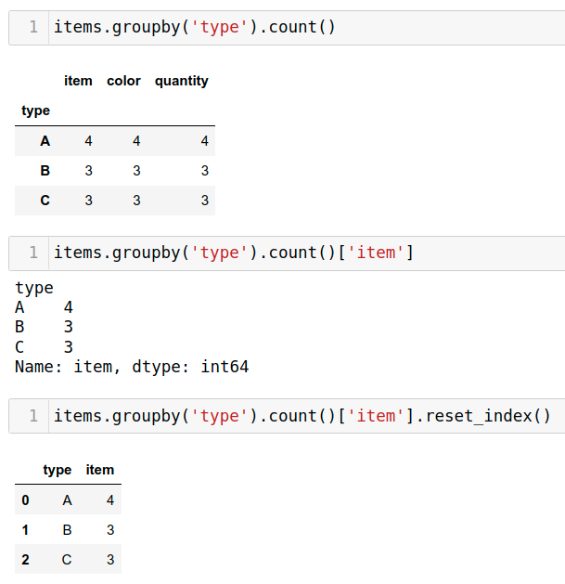
GroupBy
How many items are there of each Type?

Slide 15
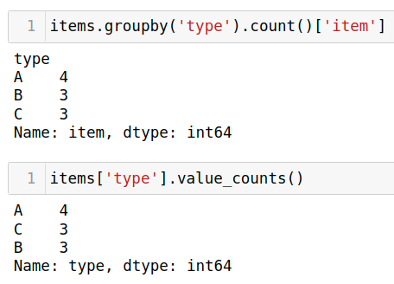
GroupBy
How many items are there of each Type?
value_counts is a convenient shortcut to count the number of entries in each category

Slide 16
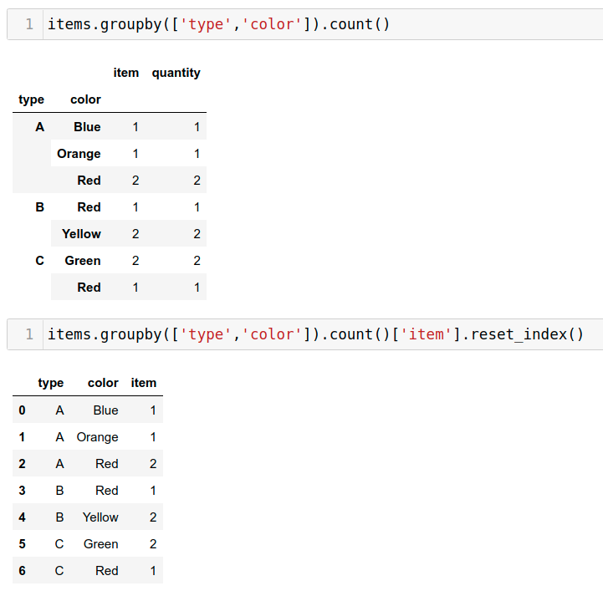
GroupBy
How many items are there for each (Type,Color ) combination ?
Notes:
And without groupby?
df.loc[(df[‘type’] == 'B') & (df[‘color’] > ‘Red’)]

Slide 17
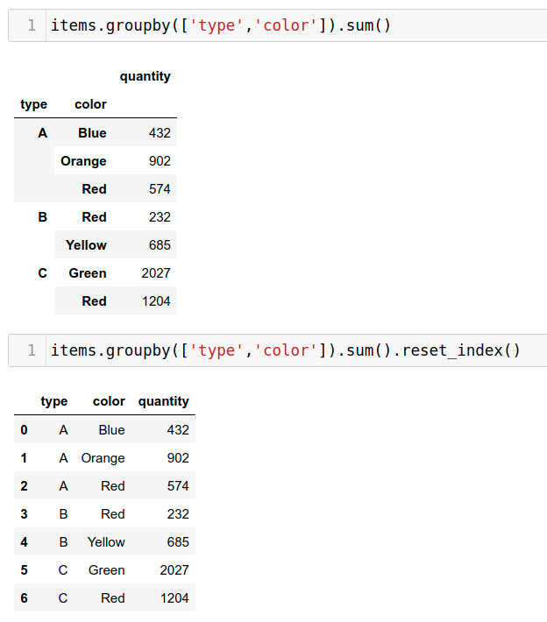
GroupBy
Find the sum of quantities for each (Type,Color ) combination ?

Slide 18
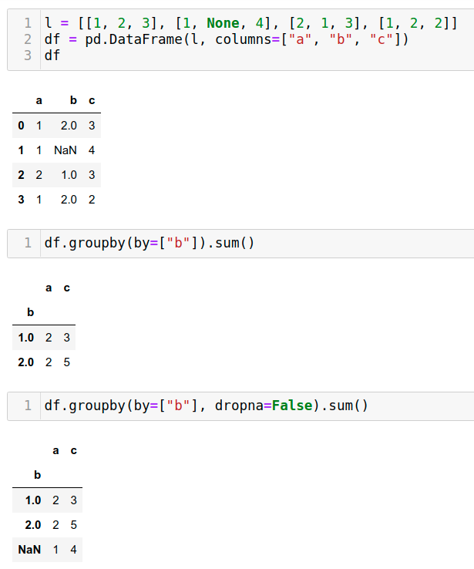
GroupBy
We can also choose to include NA in group keys or not by setting `dropna` parameter,
the default setting is `True`

Slide 19
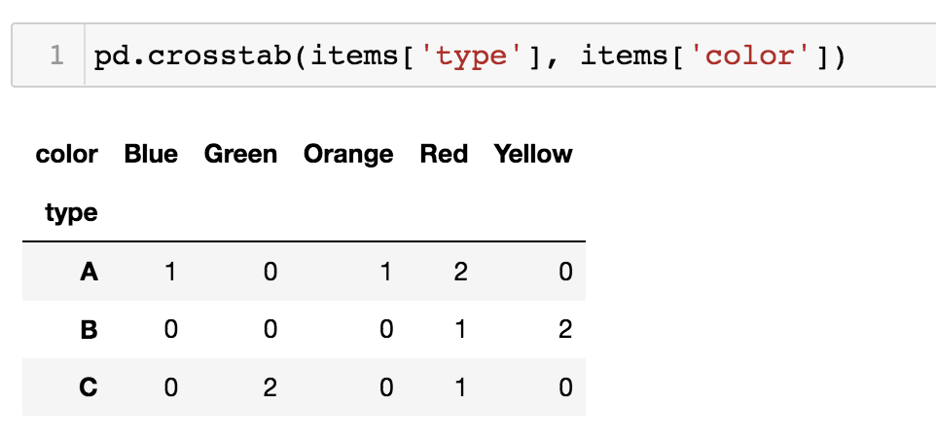
Contingency Table

Slide 20
… Exercise Time …
We divide you into 3 groups
Each group does one exercise corresponding to its group number, e.g. group 2 does “Exercise 2: Data Aggregation”
You have 15 minutes
Afterwards, one member of each group has to share their screen with the notebook and show the others what they did and why

